Slide 1
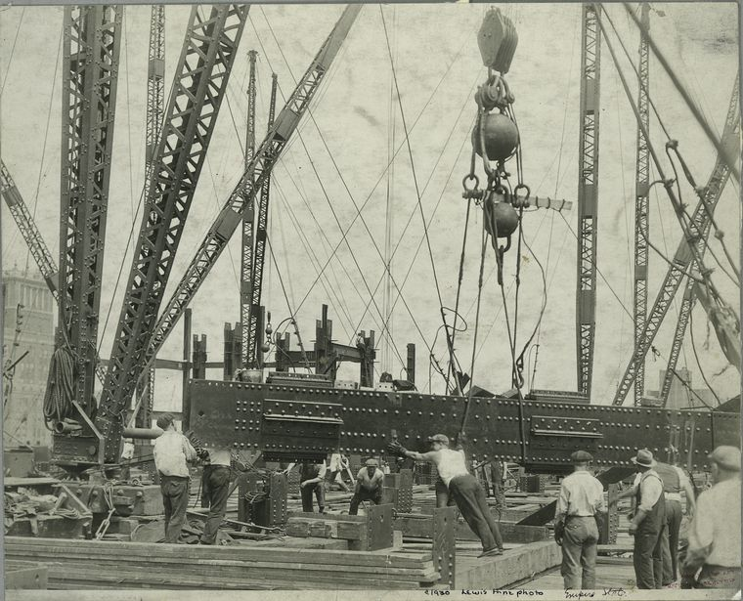
Empire State Building 1930.

Slide 2
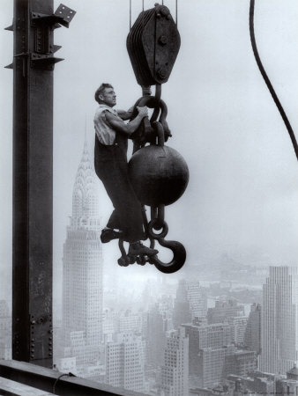
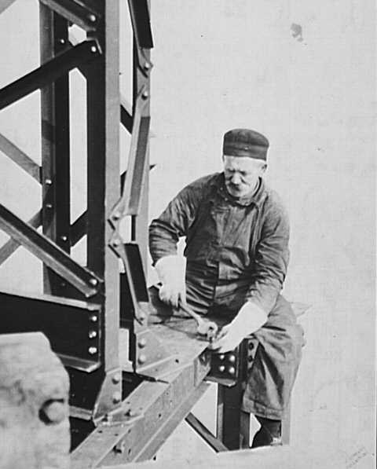
“The Empire State building was built in 1930. Safety will only be invented in the 1990’s”

Slide 3
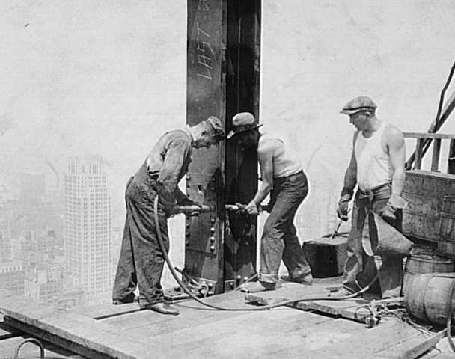
“Wow, these impact wrenches are fantastic, pity about the noise.”….”What ?”

Slide 4
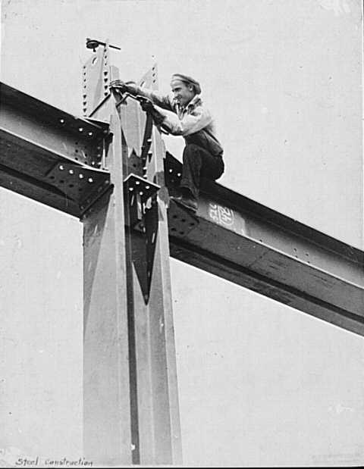
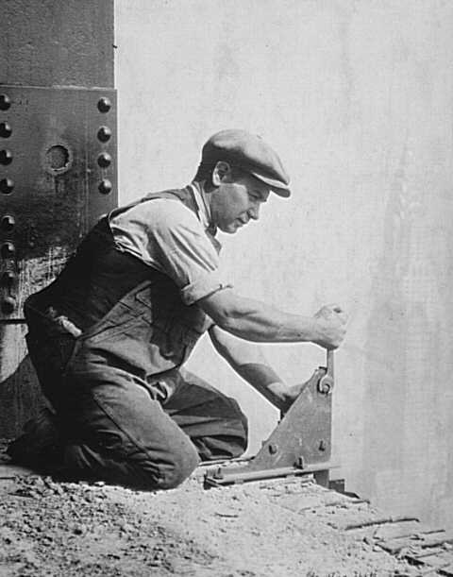
“Fall protection?, ,,,your mother’s too!”

Slide 5
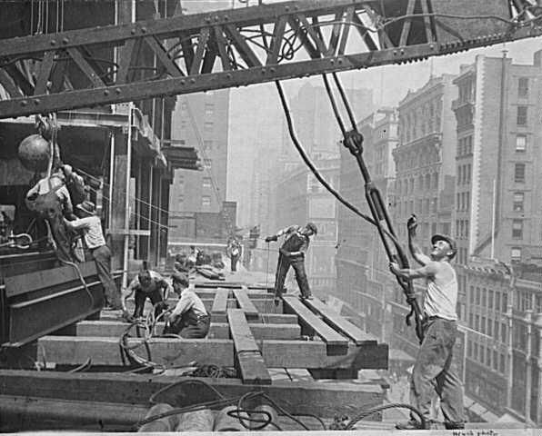
“Move it, move it, this building won’t build itself!”

Slide 6
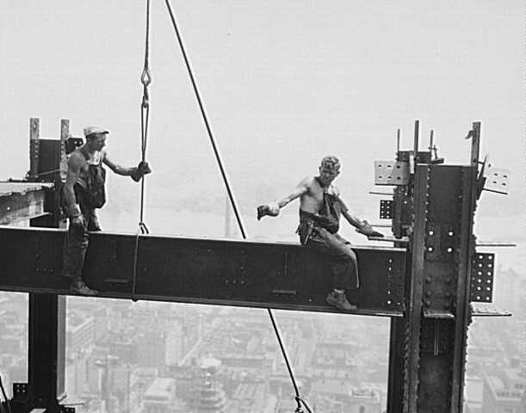
“Don’t look where I point, listen to where I think this beam must go”

Slide 7
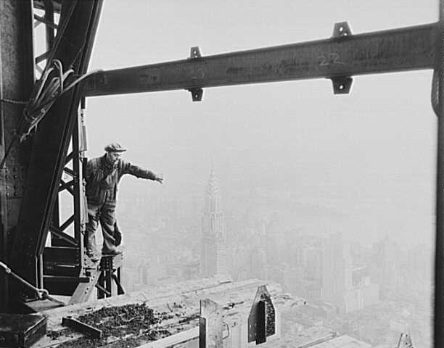
“Just a jump to the left and I’ll be safely on those loose scaffold boards”

Slide 8
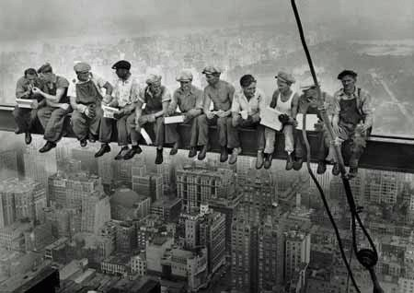
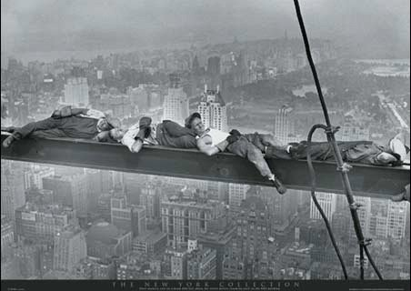
Lunch Time, time to unwind and stress-relieve.

Slide 9
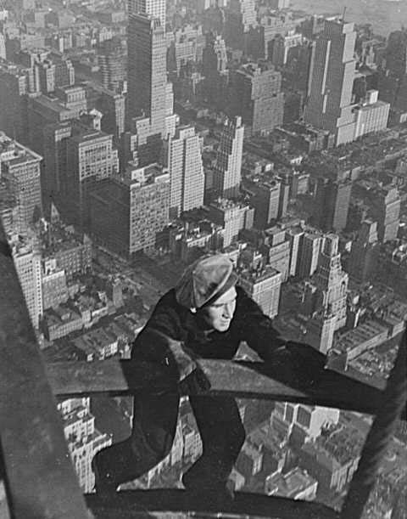
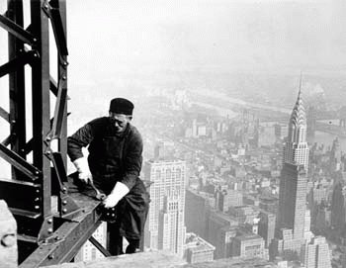
Ag-shame, the top of the Chrysler building is way down there.”

Slide 10
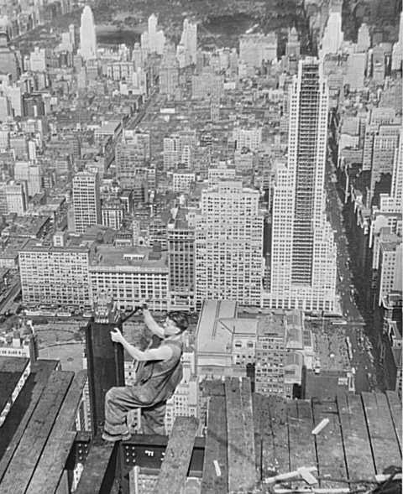
“If this spanner slips and hits me on the nose…will I bleed before hitting the sidewalk?”

Slide 11
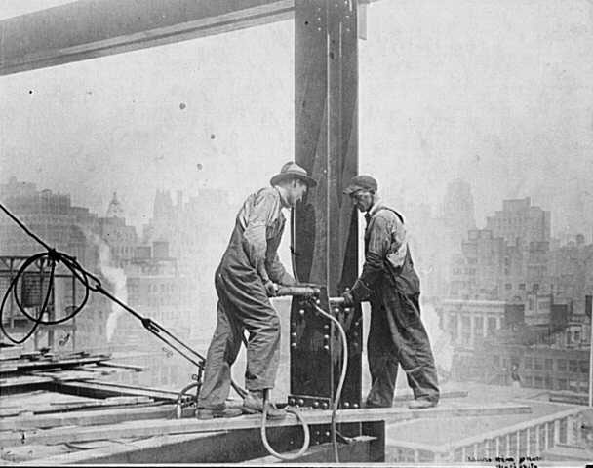
Please note the scaffold board the guy on the right is standing on.

Slide 12
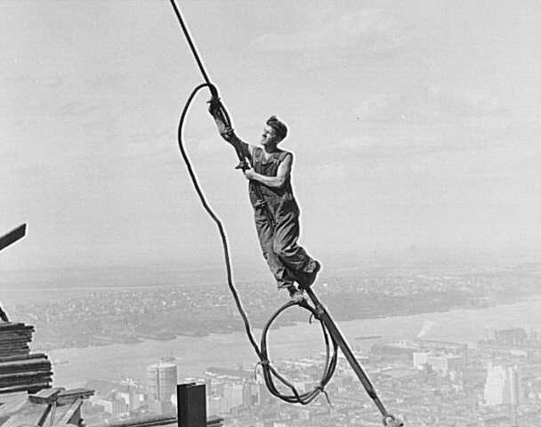
“Yeah! Boss. The nuts are all here!”

Slide 13
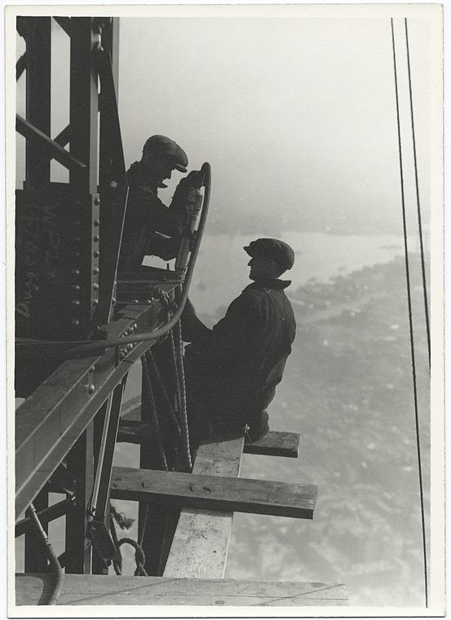
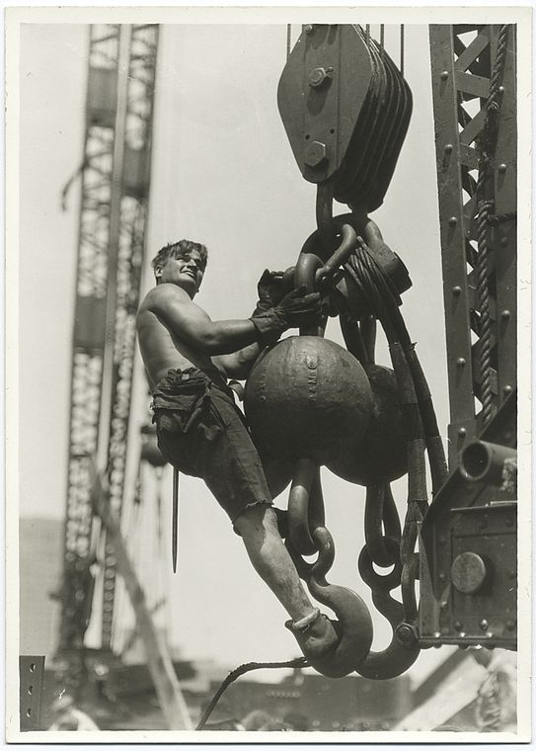
“Gloves are for freezing weather, not for show-off riggers!”

Slide 14
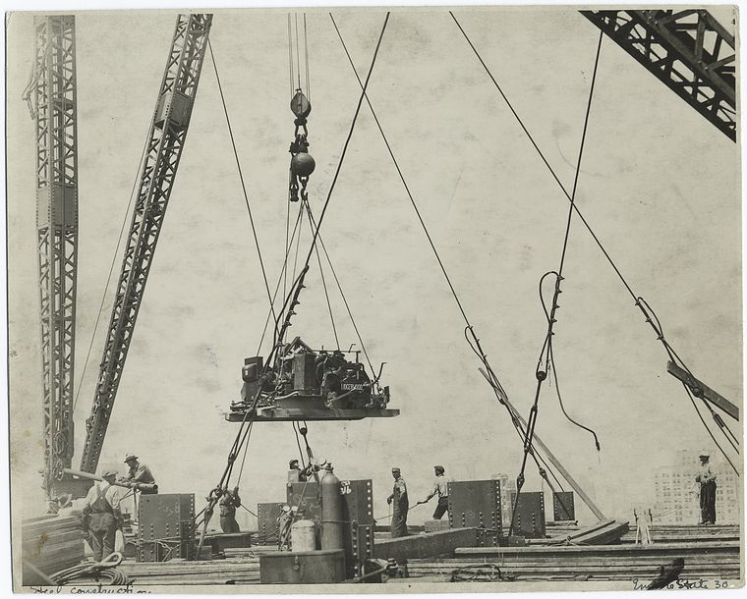

Slide 15
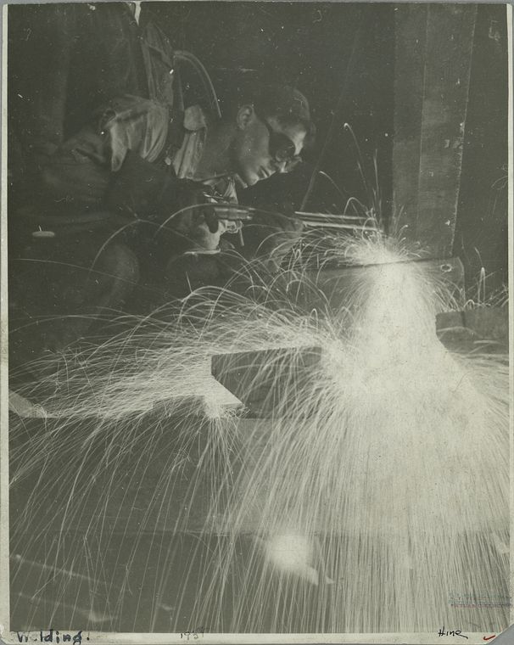
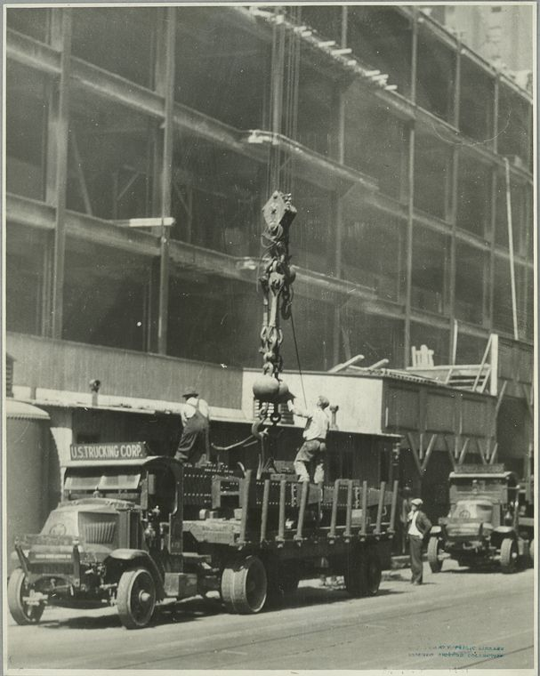
Check out the low profile tyres on the dragster truck, 1930 model.

Slide 16
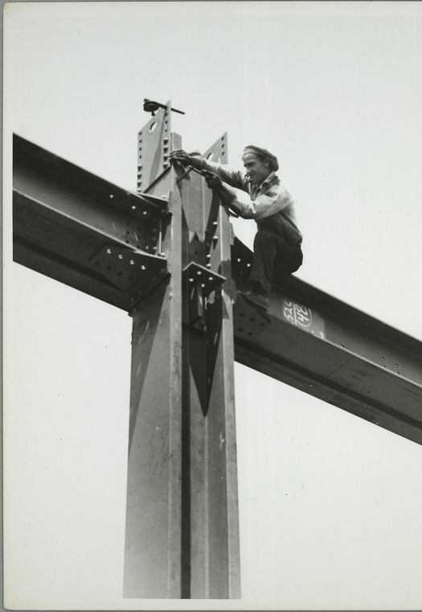
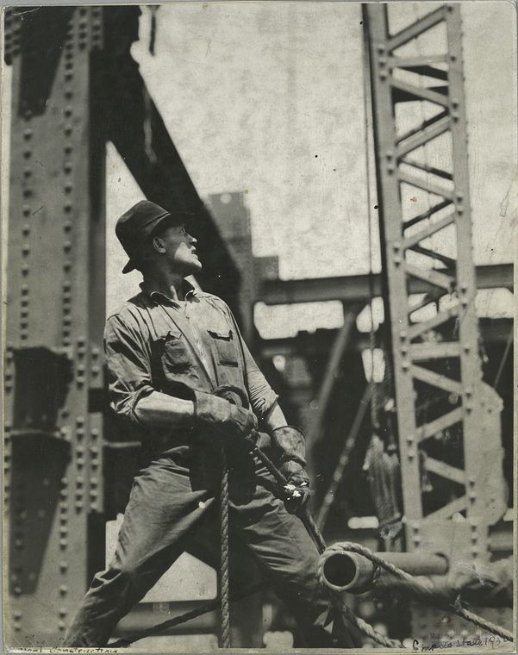
“Safety?, yeah, I’ve heard of it…..it’s that little lever on a machine-gun, to prevent you from shooting the people you actually like.”

